Slide 1



Hibernate Advanced Mappings

Slide 2
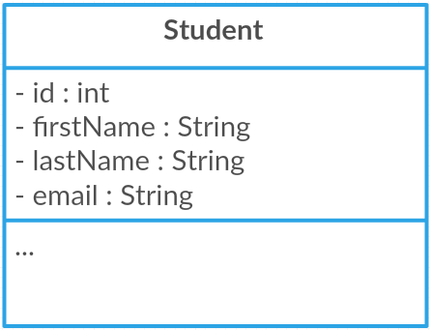
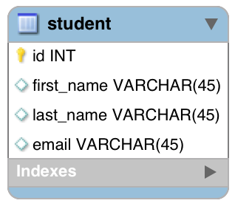
Basic Mapping
Java Class
Database Table
Hibernate
www.luv2code.com

Slide 3
Advanced Mappings
In the database, you most likely will have
Multiple Tables
Relationships between Tables
•
Need to model this with Hibernate
www.luv2code.com

Slide 4
Advanced Mappings
One-to-One
•
One-to-Many, Many-to-One
•
Many-to-Many
www.luv2code.com

Slide 5


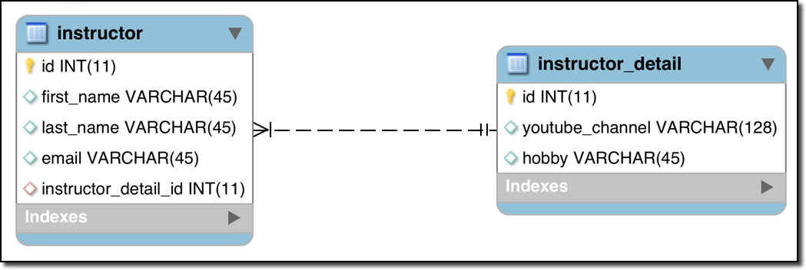
One-to-One Mapping
An instructor can have an “instructor detail” entity
Similar to an “instructor profile”
Instructor Detail
Instructor
www.luv2code.com

Slide 6




One-to-Many Mapping
An instructor can have many courses
Course
Course
Instructor
Course
Course
www.luv2code.com

Slide 7



Many-to-Many Mapping
A course can have many students
A student can have many courses
Course
Student
Course
Student
Course
Student
Course
Student
www.luv2code.com

Slide 8
Important Database Concepts
•
Primary key and foreign key
•
Cascade
www.luv2code.com

Slide 9
Primary Key and Foreign Key
Primary key: identify a unique row in a table
•
Foreign key:
Link tables together
a field in one table that refers to primary key in another table
www.luv2code.com

Slide 10

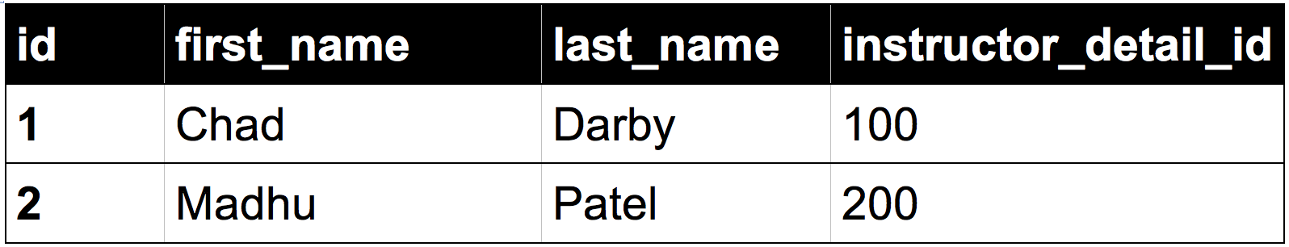
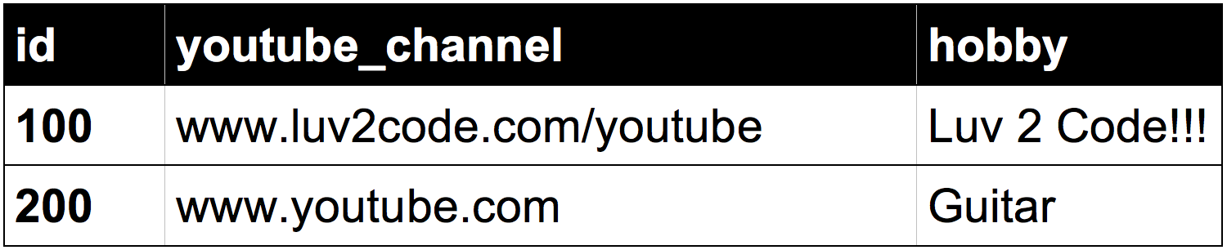

Foreign Key Example
Foreign key column
Table: instructor
Table: instructor_detail
www.luv2code.com

Slide 11



Cascade
You can cascade operations
•
Apply the same operation to related entities
Instructor Detail
Instructor
save
www.luv2code.com

Slide 12

Cascade
If we delete an instructor, we should also delete their instructor_detail
This is known as “CASCADE DELETE”
Instructor Detail
Instructor
delete
www.luv2code.com

Slide 13







Cascade Delete
Foreign key column
Table: instructor
Table: instructor_detail
www.luv2code.com

Slide 14




Cascade Delete
Developer can configure cascading
No way!!!
Cascade delete depends on the use case
Should we do cascade delete here???
Course
Student
Course
Student
Course
Student
Course
Student
www.luv2code.com

Slide 15




Fetch Types: Eager vs Lazy Loading
When we fetch / retrieve data, should we retrieve EVERYTHING?
Eager will retrieve everything
Lazy will retrieve on request
Course
Course
Instructor
Course
Course
www.luv2code.com

Slide 16


Uni-Directional
Instructor Detail
Instructor
www.luv2code.com

Slide 17


Bi-Directional
Instructor Detail
Instructor
www.luv2code.com

